Slide 1
Bipolar Junction Transistors
Since 1970, the high density and low-power advantage of the MOS technology steadily eroded the BJT’s early dominance.
BJTs are still preferred in some high-frequency and analog applications because of their high speed and high power output.

Slide 2
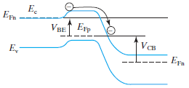
Introduction to the BJT
NPN BJT:
B
E
C
N⁺
P
N
Emitter
Base
Collector
V_{BE}
V_{CB}
I_{C} is an exponential function of forward V_{BE} and independent of reverse V_{CB}.

Slide 3
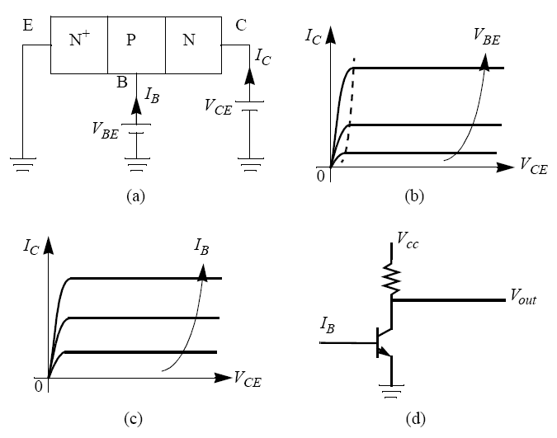
Common-Emitter Configuration

Slide 4
Collector Current
depletion layers
N
+
P
N
emitter
base
collector
x
0
W
B
τ_{B} : base recombination lifetime
D_{B} : base minority carrier (electron) diffusion constant
Boundary conditions :

Slide 5
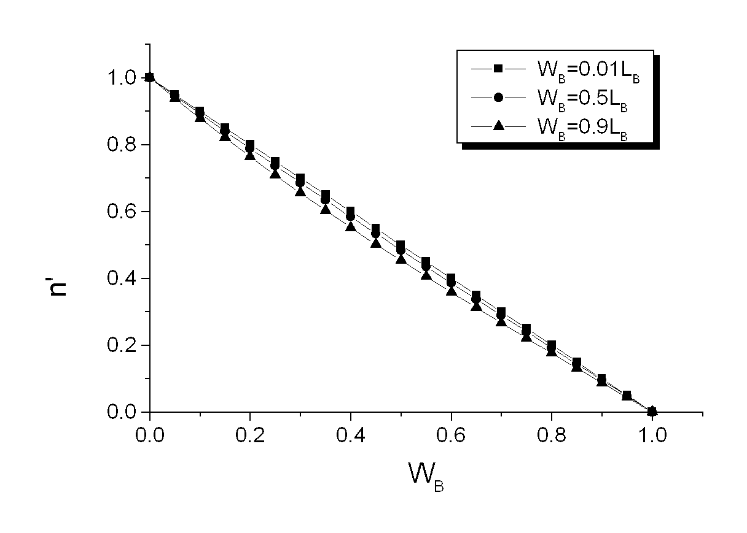

Collector Current
n
′
-------------
n
′
()
0
n
2
qV
⁄
kT
i
()
BE
1
-------e
–
1
N
B
It can be shown
0
x
/
x/
1
W
B
G_{B} (s·cm⁴) is the base Gummel number

Slide 6
High Level Injection Effect
At low-level injection,
inverse slope is 60
mV/decade
10⁻²
I_{kF}
10⁻⁴
)
A
10⁻⁶
(
C
High-level injection effect :
I
60 mV/decade
10⁻⁸
At large V_{BE,}
10⁻¹⁰
10⁻¹²
0
0.2
0.4
0.6
0.8
1.0
V
BE
When p > N_{B} , inverse slope is 120mV/decade.

Slide 7
Base Current
Some holes are injected from the P-type base into the N⁺
emitter. The holes are provided by the base current, I_{B} .
(
a
)
contact
emitter
base
collector
contact
electron flow
–
I
I
E
C
hole flow
+
p
'
n
'
I
E
B
B
W
E
W
B

Slide 8
Base Current
(
a
)
contact
emitter
base
collector
contact
electron flow
–
I
I
E
C
hole flow
+
I
B
For a uniform emitter,

Slide 9
Current Gain
Common-emitter current gain, β_{F} :
Common-base current gain:
It can be shown that

Slide 10
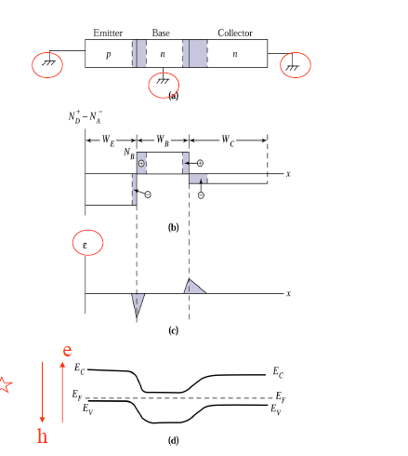

Slide 11
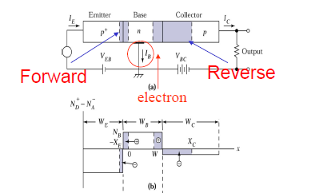
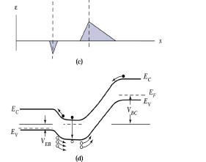

Slide 12
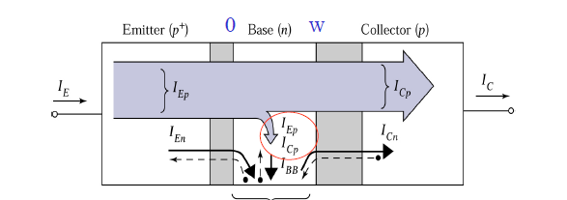

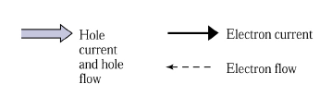

Slide 13
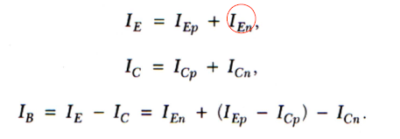



Slide 14
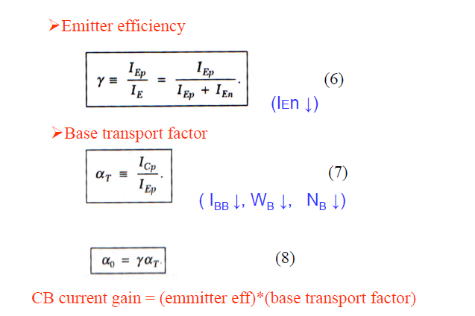

Slide 15


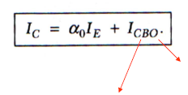



Slide 16
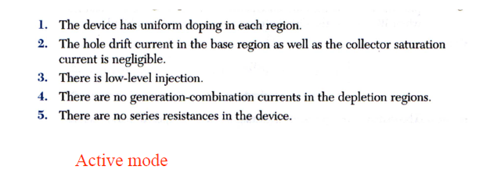


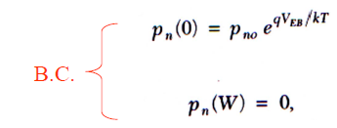

Slide 17
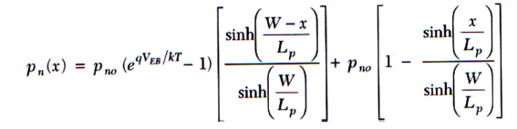
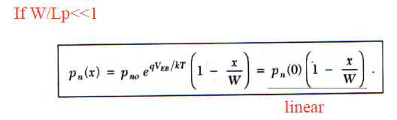
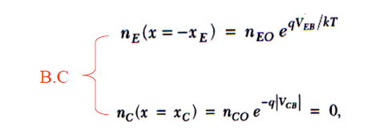

Slide 18

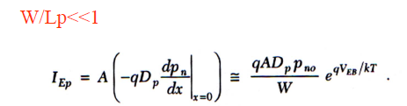
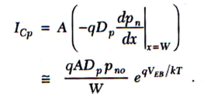

Slide 19
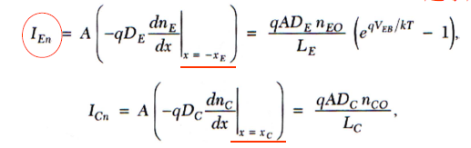
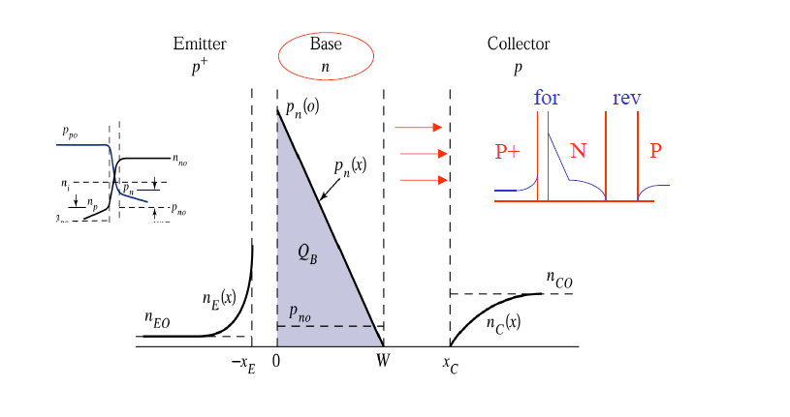

Slide 20
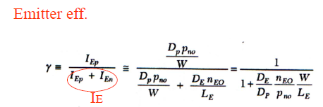



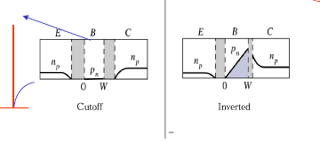
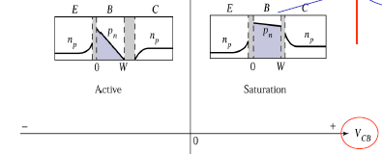



Slide 21
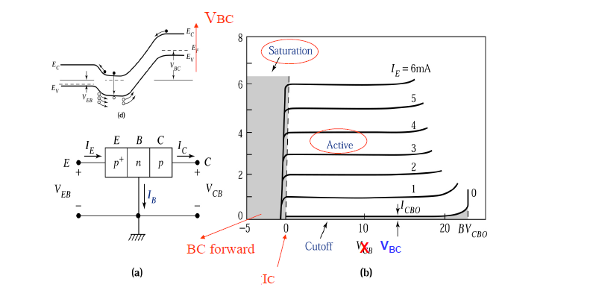

Slide 22
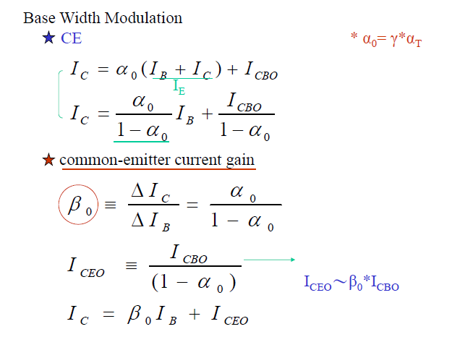

Slide 23
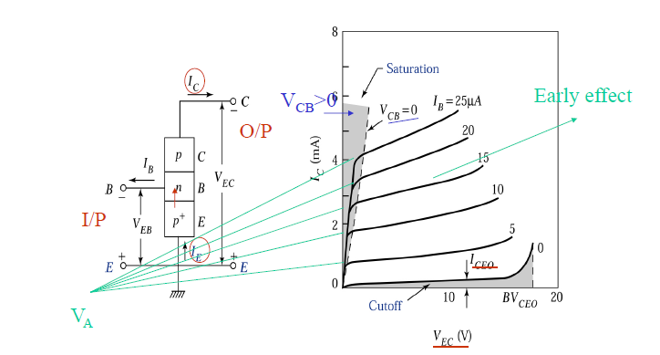

Slide 24
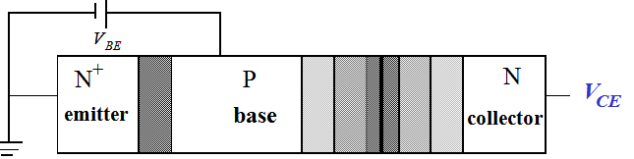
Output resistance :
Large V_{A} (large r_{o} ) is desirable for a large voltage gain
Base-Width Modulation by Collector Voltage

Slide 25
Base-Width Modulation by Collector Voltage
V
BE
N
+
P
N
V
CE
emitter
base
collector
W
}
B
3
W
V
<
V
<
V
B
2
CE
1
CE
2
CE
3
W
B
1
n'
x

Slide 26
Base-Width Modulation by Collector Voltage
V
The base-width modulation
effect is reduced if we
(A) Increase the base width,
(B) Increase the base doping
concentration, N_{B} , or
(C) Decrease the collector doping
concentration, N_{C} .
Which of the above is the most acceptable action?
BE
N
+
P
N
V
CE
emitter
base
collector
W
}
B
3
W
B
2
V
<
V
<
V
W
CE
1
CE
2
CE
3
B
1
n'
x

